Slide 1

LET US C
BY YASHAVANT KANETKAR
CH 14 Q[B]
CH 14 Q[A]
CHAPTER 14 SOLUTIONS
MULTIDIMENSIONAL ARRAYS

Slide 2
CHAPTER 14 SOLUTIONS
MULTIDIMENSIONAL ARRAYS
Q[A] What will be the output of the following programs:
CH 14 Q[A]
(c)
(a)
(b)
#include <stdio.h>
int main()
{
int n[3][3] = {
2, 4, 3,
6, 8, 5,
3, 5, 1
};
printf("%d %d %d\n", *n, n[ 3 ][ 3 ], n[ 2 ][ 2 ]);
return 0;
}
#include <stdio.h>
int main()
{
int n[3][3] = {
2, 4, 3,
6, 8, 5,
3, 5, 1
};
int i, *ptr;
ptr = n;
for (i = 0; i <= 8; i++)
printf("%d\n", *(ptr + i));
return 0;
}
CH 14 Q[C]
CH 14 Q[B]
DEAR CODING
BOOK: LET US C
BY YASHAVANT KANETKAR

Slide 3

CHAPTER 14 SOLUTIONS
MULTIDIMENSIONAL ARRAYS
(a)
#include <stdio.h>
int main()
{
int n[3][3] = {
2, 4, 3,
6, 8, 5,
3, 5, 1
};
printf("%d %d %d\n", *n, n[ 3 ][ 3 ], n[ 2 ][ 2 ]);
return 0;
}
👩‍💻 Output:
CH 14 Q[A](a)
DEAR CODING
✍️ For a 2D array: a, *a will give address.
**a will give the integer at a[0][0][0].
✍️ Array indexing starts at 0.
BOOK: LET US C
BY YASHAVANT KANETKAR

Slide 4
CHAPTER 14 SOLUTIONS
MULTIDIMENSIONAL ARRAYS
(b)
#include <stdio.h>
int main()
{
int n[3][3] = {
2, 4, 3,
6, 8, 5,
3, 5, 1
};
int i, *ptr;
ptr = n;
for (i = 0; i <= 8; i++)
printf("%d\n", *(ptr + i));
return 0;
}
👩‍💻 Output:
CH 14 Q[A](b)
✍️ n stores the address of an array.
While n is an integer pointer.
DEAR CODING
BOOK: LET US C
BY YASHAVANT KANETKAR

Slide 5
CHAPTER 14 SOLUTIONS
MULTIDIMENSIONAL ARRAYS
(b)
#include <stdio.h>
int main()
{
int n[3][3] = {
2, 4, 3,
6, 8, 5,
3, 5, 1
};
int i, *ptr;
ptr = n;
for (i = 0; i <= 8; i++)
printf("%d\n", *(ptr + i));
return 0;
}
👩‍💻 Output:
CH 14 Q[A](b)
DEAR CODING
BOOK: LET US C
BY YASHAVANT KANETKAR

Slide 6

CHAPTER 14 SOLUTIONS
MULTIDIMENSIONAL ARRAYS
(c)
#include <stdio.h>
int main()
{
int n[3][3] = {
2, 4, 3,
6, 8, 5,
3, 5, 1
};
int i,j;
for (i = 0; i <= 2; i++)
for (j = 0; j <= 2; j++)
printf("%d %d\n", n[i][j], *(*(n+i)+j));
return 0;
}
👩‍💻 Output:
CH 14 Q[A](c)
DEAR CODING
BOOK: LET US C
BY YASHAVANT KANETKAR

Slide 7
CHAPTER 14 SOLUTIONS
MULTIDIMENSIONAL ARRAYS
Q[B] What will be the output of the following programs:
CH 14 Q[B]
(b)
(a)
#include <stdio.h>
int main()
{
int three[ 3 ][] = {
2, 4, 3,
6, 8, 2,
2, 3, 1
};
printf("%d\n", three[1][1]);
return 0;
}
#include <stdio.h>
int main()
{
int twod[][] = {
2,4,
6,8
};
printf("%d\n", twod);
return 0;
}
DEAR CODING
BOOK: LET US C
BY YASHAVANT KANETKAR

Slide 8
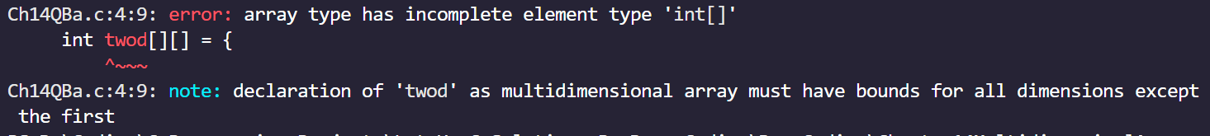
CHAPTER 14 SOLUTIONS
MULTIDIMENSIONAL ARRAYS
(a)
#include <stdio.h>
int main()
{
int twod[][] = {
2,4,
6,8
};
printf("%d\n", twod);
return 0;
}
✍️ The code snippet attempts to declare and initialize a 2D array twod without specifying the size for the second dimension. However, this is not allowed in C.
CH 14 Q[B](a)
DEAR CODING
BOOK: LET US C
BY YASHAVANT KANETKAR

Slide 9
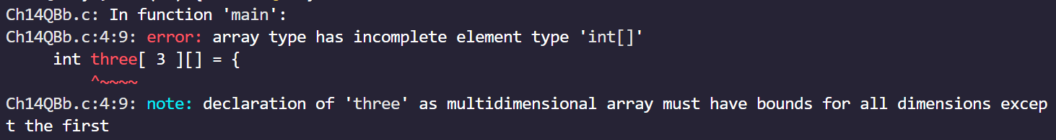
CHAPTER 14 SOLUTIONS
MULTIDIMENSIONAL ARRAYS
(b)
#include <stdio.h>
int main()
{
int three[ 3 ][] = {
2, 4, 3,
6, 8, 2,
2, 3, 1
};
printf("%d\n", three[1][1]);
return 0;
}
✍️ In C, a[3][2] and a[ ][2] are perfectly valid.
CH 14 Q[B](b)
✍️ a[3][ ] and a[ ][ ] are invalid.
DEAR CODING
BOOK: LET US C
BY YASHAVANT KANETKAR

Slide 10
CHAPTER 14 SOLUTIONS
MULTIDIMENSIONAL ARRAYS
Q[C] Attempt the following:
(a) How will you initialize a three-dimensional array threed[ 3 ][ 2 ][ 3 ]? How will you refer the first and last element in this array?
CH 14 Q[C](a)
DEAR CODING
BOOK: LET US C
BY YASHAVANT KANETKAR

Slide 11
CHAPTER 14 SOLUTIONS
MULTIDIMENSIONAL ARRAYS
Q[C] Attempt the following:
(b) Write a program to pick up the largest number from any 5 row by 5 column matrix.
CH 14 Q[C](b)
DEAR CODING
BOOK: LET US C
BY YASHAVANT KANETKAR

Slide 12
CHAPTER 14 SOLUTIONS
MULTIDIMENSIONAL ARRAYS
Q[C] Attempt the following:
(c) Write a program to obtain transpose of a 4 x 4 matrix. The transpose of a matrix is obtained by exchanging the elements of each row with the elements of the corresponding column.
CH 14 Q[C](c)
DEAR CODING
BOOK: LET US C
BY YASHAVANT KANETKAR

Slide 13
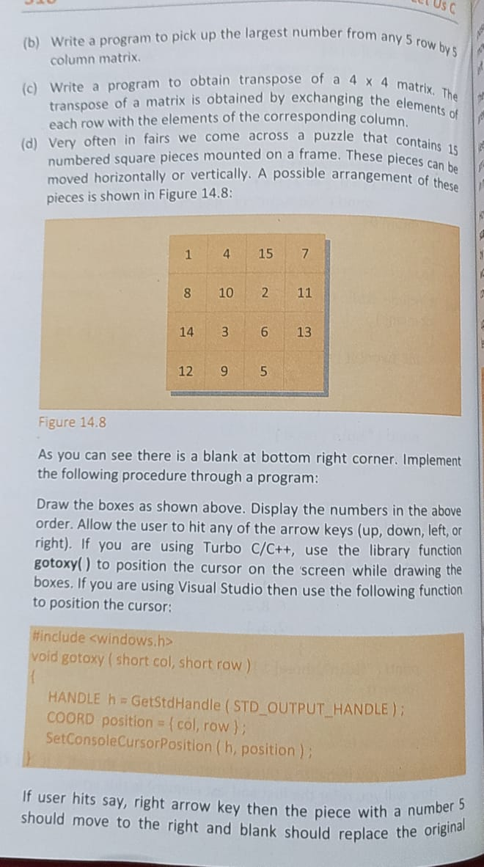
CHAPTER 14 SOLUTIONS
MULTIDIMENSIONAL ARRAYS
Q[C] Attempt the following:
(d) Very often in fairs we come across a puzzle that contains 15 numbered square pieces mounted on a frame. These pieces can be moved horizontally or vertically. A possible arrangement of these pieces is shown in Figure 14.8:
CH 14 Q[C](d)
DEAR CODING
BOOK: LET US C
BY YASHAVANT KANETKAR

Slide 14
CHAPTER 14 SOLUTIONS
MULTIDIMENSIONAL ARRAYS
Q[C](d) As you can see there is a blank at bottom right corner. Implement the following procedure through a program:
CH 14 Q[C](d)
DEAR CODING
BOOK: LET US C
BY YASHAVANT KANETKAR

Slide 15
CHAPTER 14 SOLUTIONS
MULTIDIMENSIONAL ARRAYS
Q[C](d) Draw the boxes as shown above. Display the numbers in the above order. Allow the user to hit any of the arrow keys (up, down, left, or right). If you are using Turbo C/C++, use the library function gotoxy() to position the cursor on the screen while drawing the boxes. If you are using Visual Studio then use the following function to position the cursor:
CH 14 Q[C](d)
DEAR CODING
BOOK: LET US C
BY YASHAVANT KANETKAR

Slide 16
CHAPTER 14 SOLUTIONS
MULTIDIMENSIONAL ARRAYS
Q[C] Attempt the following:
(d) If user hits say, right arrow key then the piece with a number 5 should move to the right and blank should replace the original position of 5. Similarly, if down arrow key is hit, then 13 should move down and blank should replace the original position of 13. If left arrow key or up arrow key is hit then no action should be taken.
The user would continue hitting the arrow keys till the numbers aren't arranged in ascending order.
CH 14 Q[C](d)
DEAR CODING
BOOK: LET US C
BY YASHAVANT KANETKAR

Slide 17
CHAPTER 14 SOLUTIONS
MULTIDIMENSIONAL ARRAYS
Q[C](d): Keep arrange the numbers in ascending order. The user who manages it in minimum number of moves is the one who wins.
How do we tackle the arrow keys? We cannot receive them using scanf() function. Arrow keys are special keys which are identified by their 'scan codes. Use the following function in your program. It would return the scan code of the arrow key being hit. The scan codes for the arrow keys are:
up arrow key - 72 down arrow key -80
left arrow key - 75 right arrow key - 77
CH 14 Q[C](d)
DEAR CODING
BOOK: LET US C
BY YASHAVANT KANETKAR

Slide 18
CHAPTER 14 SOLUTIONS
MULTIDIMENSIONAL ARRAYS
Q[C] Attempt the following:
(e) Match the following with reference to the program segment given below:
CH 14 Q[C](e)
DEAR CODING
BOOK: LET US C
BY YASHAVANT KANETKAR

Slide 19
CHAPTER 14 SOLUTIONS
MULTIDIMENSIONAL ARRAYS
#include <stdio.h>
int main()
{
int i, j = 25;
int *pi, *pj = &j;
// More Lines
// of program
*pj = j + 5;
pj = pj;
*pi = i + j;
return 0;
}
CH 14 Q[C](e)
DEAR CODING
BOOK: LET US C
BY YASHAVANT KANETKAR

Slide 20
CHAPTER 14 SOLUTIONS
MULTIDIMENSIONAL ARRAYS
Q[C] Attempt the following:
(e) Each integer quantity occupies 2 bytes of memory. The value assigned to i begin at (hexadecimal) address F9C and the value assigned to j begins at address F9E. Match the value represented by left hand side quantities with the right.
CH 14 Q[C](e)
DEAR CODING
BOOK: LET US C
BY YASHAVANT KANETKAR

Slide 21
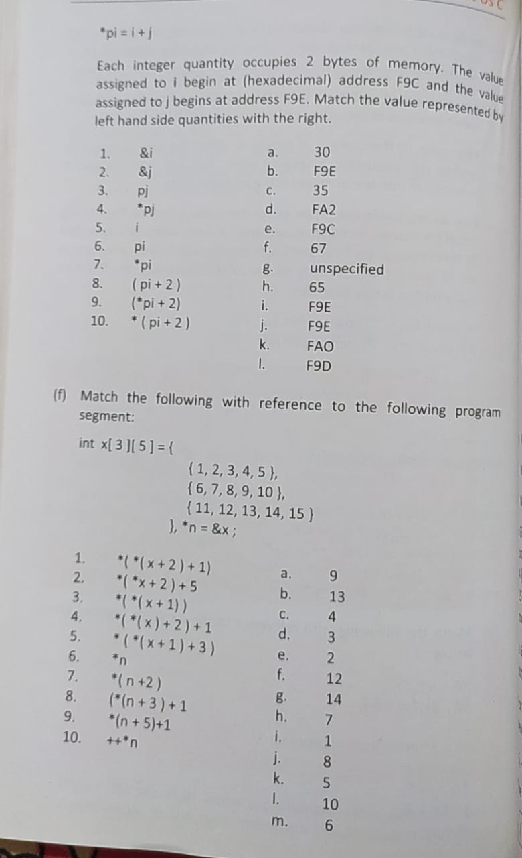
CHAPTER 14 SOLUTIONS
MULTIDIMENSIONAL ARRAYS
Q[C](e)
CH 14 Q[C](e)
DEAR CODING
BOOK: LET US C
BY YASHAVANT KANETKAR

Slide 22
CHAPTER 14 SOLUTIONS
MULTIDIMENSIONAL ARRAYS
#include <stdio.h>
int main()
{
int i, j = 25;
int *pi, *pj = &j;
// More Lines
// of program
*pj = j + 5;
pj = pj;
*pi = i + j;
return 0;
}
printf("%d\n", &i);
// Output: 6422028
printf("%d\n", &j);
// Output: 6422024 (b),(i),(j)
printf("%d\n", pj);
// Output: 6422024 (b),(i),(j)
printf("%d\n", *pj);
// Output: 30 (a)
printf("%d\n", i);
// Output: 0
CH 14 Q[C](e)
DEAR CODING
BOOK: LET US C
BY YASHAVANT KANETKAR

Slide 23
CHAPTER 14 SOLUTIONS
MULTIDIMENSIONAL ARRAYS
#include <stdio.h>
int main()
{
int i, j = 25;
int *pi, *pj = &j;
// More Lines
// of program
*pj = j + 5;
pj = pj;
*pi = i + j;
return 0;
}
printf("%d\n", &i);
// Output: 6422028
printf("%d\n", &j);
// Output: 6422024 (b),(i),(j)
printf("%d\n", pj);
// Output: 6422024 (b),(i),(j)
printf("%d\n", *pj);
// Output: 30 (a)
printf("%d\n", i);
// Output: 0
CH 14 Q[C](e)
DEAR CODING
BOOK: LET US C
BY YASHAVANT KANETKAR

Slide 24
CHAPTER 14 SOLUTIONS
MULTIDIMENSIONAL ARRAYS
Q[C] Attempt the following:
(f) Match the following with reference to the following program segment:
CH 14 Q[C](f)
DEAR CODING
BOOK: LET US C
BY YASHAVANT KANETKAR

Slide 25
CHAPTER 14 SOLUTIONS
MULTIDIMENSIONAL ARRAYS
#include <stdio.h>
int main()
{
int x[3][5] = {
{1, 2, 3, 4, 5},
{6, 7, 8, 9, 10},
{11, 12, 13, 14, 15}
}, *n = &x;
return 0;
}
CH 14 Q[C](f)
DEAR CODING
BOOK: LET US C
BY YASHAVANT KANETKAR

Slide 26
CHAPTER 14 SOLUTIONS
MULTIDIMENSIONAL ARRAYS
Q[C](f)
CH 14 Q[C](f)
DEAR CODING
BOOK: LET US C
BY YASHAVANT KANETKAR

Slide 27
CHAPTER 14 SOLUTIONS
MULTIDIMENSIONAL ARRAYS
#include <stdio.h>
int main()
{
int x[3][5] = {
{1, 2, 3, 4, 5},
{6, 7, 8, 9, 10},
{11, 12, 13, 14, 15}
}, *n = &x;
return 0;
}
printf("%d\n", *(*(x+2)+1));
// Output: 12 (f)
printf("%d\n", *(*x+2)+5);
// Output: 8 (j)
printf("%d\n", *(*(x+1)));
// Output: 6 (m)
printf("%d\n", *(*(x)+2)+1);
// Output: 4 (c)
printf("%d\n", *(*(x+1)+3));
// Output: 9 (a)
CH 14 Q[C](f)
DEAR CODING
BOOK: LET US C
BY YASHAVANT KANETKAR

Slide 28
CHAPTER 14 SOLUTIONS
MULTIDIMENSIONAL ARRAYS
#include <stdio.h>
int main()
{
int x[3][5] = {
{1, 2, 3, 4, 5},
{6, 7, 8, 9, 10},
{11, 12, 13, 14, 15}
}, *n = &x;
return 0;
}
printf("%d\n", *n);
// Output: 1 (i)
printf("%d\n", *(n+2));
// Output: 3 (d)
printf("%d\n", (*(n+3)+1));
// Output: 5 (k)
printf("%d\n", *(n+5)+1);
// Output: 7 (h)
printf("%d\n",++*n);
// Output: 2 (e)
CH 14 Q[C](f)
DEAR CODING
BOOK: LET US C
BY YASHAVANT KANETKAR

Slide 29
CHAPTER 14 SOLUTIONS
MULTIDIMENSIONAL ARRAYS
Q[C] Attempt the following:
(g) Match the following with reference to the following program segment:
CH 14 Q[C](g)
DEAR CODING
BOOK: LET US C
BY YASHAVANT KANETKAR

Slide 30
CHAPTER 14 SOLUTIONS
MULTIDIMENSIONAL ARRAYS
#include <stdio.h>
int main()
{
int x[3][5] = {
{1, 2, 3, 4, 5},
{6, 7, 8, 9, 10},
{11, 12, 13, 14, 15}
}, *n = &x;
return 0;
}
CH 14 Q[C](g)
DEAR CODING
BOOK: LET US C
BY YASHAVANT KANETKAR

Slide 31
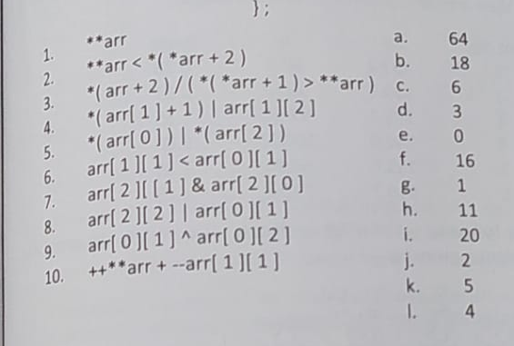
CHAPTER 14 SOLUTIONS
MULTIDIMENSIONAL ARRAYS
Q[C](g)
CH 14 Q[C](g)
DEAR CODING
BOOK: LET US C
BY YASHAVANT KANETKAR

Slide 32
CHAPTER 14 SOLUTIONS
MULTIDIMENSIONAL ARRAYS
#include <stdio.h>
int main()
{
int x[3][5] = {
{1, 2, 3, 4, 5},
{6, 7, 8, 9, 10},
{11, 12, 13, 14, 15}
}, *n = &x;
return 0;
}
#include <stdio.h>
int main()
{
unsigned int arr[3][3] = {
2, 4, 6,
9, 1, 10,
16, 64, 5,
};
return 0;
}
printf("%d\n", **arr);
// Output: 2 (j)
printf("%d\n", **arr<*(*arr+2));
// Output: 1 (g)
printf("%d\n", *(arr+2)/(*(arr+1)>**arr)); // Output: error: invalid operands to binary / (have 'unsigned int *' and 'int')
CH 14 Q[C](g)
DEAR CODING
BOOK: LET US C
BY YASHAVANT KANETKAR

Slide 33
CHAPTER 14 SOLUTIONS
MULTIDIMENSIONAL ARRAYS
#include <stdio.h>
int main()
{
int x[3][5] = {
{1, 2, 3, 4, 5},
{6, 7, 8, 9, 10},
{11, 12, 13, 14, 15}
}, *n = &x;
return 0;
}
#include <stdio.h>
int main()
{
unsigned int arr[3][3] = {
2, 4, 6,
9, 1, 10,
16, 64, 5,
};
return 0;
}
printf("%d\n", *(arr[1]+1)|(arr[1][2]));
// Output: 11 (h)
printf("%d\n", *(arr[0])|*(arr[2]));
// Output: 18 (b)
printf("%d\n", arr[1][1]<arr[0][1]);
// Output: 1 (g)
CH 14 Q[C](g)
DEAR CODING
BOOK: LET US C
BY YASHAVANT KANETKAR

Slide 34
CHAPTER 14 SOLUTIONS
MULTIDIMENSIONAL ARRAYS
#include <stdio.h>
int main()
{
int x[3][5] = {
{1, 2, 3, 4, 5},
{6, 7, 8, 9, 10},
{11, 12, 13, 14, 15}
}, *n = &x;
return 0;
}
#include <stdio.h>
int main()
{
unsigned int arr[3][3] = {
2, 4, 6,
9, 1, 10,
16, 64, 5,
};
return 0;
}
printf("%d\n", arr[2][1]&arr[2][0]);
// Output: 0 (e)
printf("%d\n", arr[2][2]|arr[0][1]);
// Output: 5 (k)
printf("%d\n", arr[0][1]^arr[0][2]);
// Output: 2 (j)
printf("%d\n", ++**arr + --arr[1][1]);
// Output: 3 (d)
CH 14 Q[C](g)
DEAR CODING
BOOK: LET US C
BY YASHAVANT KANETKAR

Slide 35
CHAPTER 14 SOLUTIONS
MULTIDIMENSIONAL ARRAYS
Q[C] Attempt the following:
(h) Write a program to find if a square matrix is symmetric.
CH 14 Q[C](h)
DEAR CODING
BOOK: LET US C
BY YASHAVANT KANETKAR

Slide 36
CHAPTER 14 SOLUTIONS
MULTIDIMENSIONAL ARRAYS
Q[C] Attempt the following:
(i) Write a program to add two 6 x 6 matrices.
CH 14 Q[C](i)
DEAR CODING
BOOK: LET US C
BY YASHAVANT KANETKAR

Slide 37
CHAPTER 14 SOLUTIONS
MULTIDIMENSIONAL ARRAYS
Q[C] Attempt the following:
(j) Write a program to multiply any two 3 x 3 matrices.
CH 14 Q[C](j)
DEAR CODING
BOOK: LET US C
BY YASHAVANT KANETKAR

Slide 38
CHAPTER 14 SOLUTIONS
MULTIDIMENSIONAL ARRAYS
Q[C] Attempt the following:
(k) Given an array p[ 5 ], write a function to shift it circularly left by two positions. Thus, if p[0]= 15, p[ 1 ]= 30, p[ 2 ] = 28, p[ 3 ]= 19 and p[ 4]=61 then after the shift p[0] = 28, p[1] = 19, p[2] = 61, p[3] = 15 and p[4]= 30. Call this function for a (4 x 5) matrix and get its rows left shifted.
CH 14 Q[C](k)
DEAR CODING
BOOK: LET US C
BY YASHAVANT KANETKAR

Slide 39
CHAPTER 14 SOLUTIONS
MULTIDIMENSIONAL ARRAYS
Q[C] Attempt the following:
(l) A 6 x 6 matrix is entered through the keyboard. Write a program to obtain the Determinant value of this matrix.
CH 14 Q[C](l)
DEAR CODING
BOOK: LET US C
BY YASHAVANT KANETKAR

Slide 40
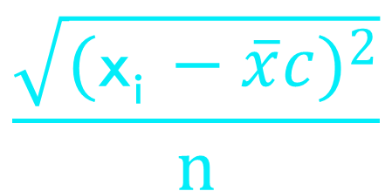
CHAPTER 14 SOLUTIONS
MULTIDIMENSIONAL ARRAYS
Q[C] Attempt the following:
(m) For the following set of sample data, compute the standard deviation and the mean.
-6, -12, 8, 13, 11, 6, 7, 2, -6, -9, -10, 11, 10, 9, 2
The formula for standard deviation is
CH 14 Q[C](m)
$$\frac{\sqrt{({\text{x}\text{i} −\overline{x}c)}^{2}}}{n}$$
DEAR CODING
$$\text{where} \text{xi} \text{is} \text{the} \text{data} \text{item} \text{and} \overline{x} \text{is} \text{the} \text{mean}\text{.}$$
BOOK: LET US C
BY YASHAVANT KANETKAR

Slide 41
CHAPTER 14 SOLUTIONS
MULTIDIMENSIONAL ARRAYS
Q[C] Attempt the following:
(n) The area of a triangle can be computed by the sine law when sides of the triangle and the angle between them are known.
Area = (1/2) ab sin (angle)
Given the following 6 triangular pieces of land, write a program to find their area and determine which is largest.
CH 14 Q[C](n)
DEAR CODING
BOOK: LET US C
BY YASHAVANT KANETKAR

Slide 42
CHAPTER 14 SOLUTIONS
MULTIDIMENSIONAL ARRAYS
Q[C] Attempt the following:
(n) The area of a triangle can be computed by the sine law when sides of the triangle and the angle between them are known.
Area = (1/2) ab sin (angle)
Given the following 6 triangular pieces of land, write a program to find their area and determine which is largest.
CH 14 Q[C](n)
DEAR CODING
BOOK: LET US C
BY YASHAVANT KANETKAR

Slide 43
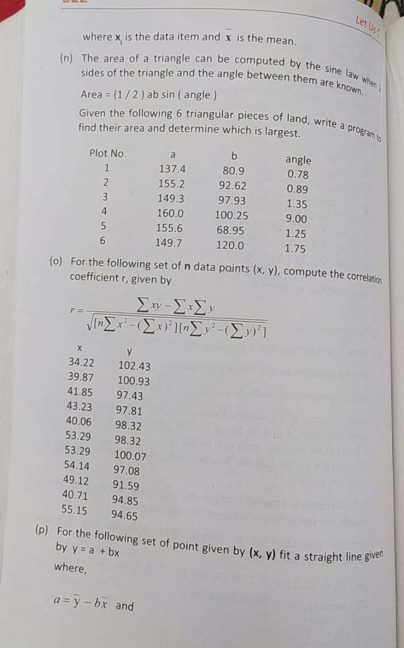
CHAPTER 14 SOLUTIONS
MULTIDIMENSIONAL ARRAYS
CH 14 Q[C](n)
DEAR CODING
BOOK: LET US C
BY YASHAVANT KANETKAR

Slide 44
CHAPTER 14 SOLUTIONS
MULTIDIMENSIONAL ARRAYS
Q[C] Attempt the following:
(o) For the following set of n data points (x, y), compute the correlation coefficient r, given by
CH 14 Q[C](o)
DEAR CODING
BOOK: LET US C
BY YASHAVANT KANETKAR

Slide 45
CHAPTER 14 SOLUTIONS
MULTIDIMENSIONAL ARRAYS
CH 14 Q[C](o)
DEAR CODING
BOOK: LET US C
BY YASHAVANT KANETKAR

Slide 46
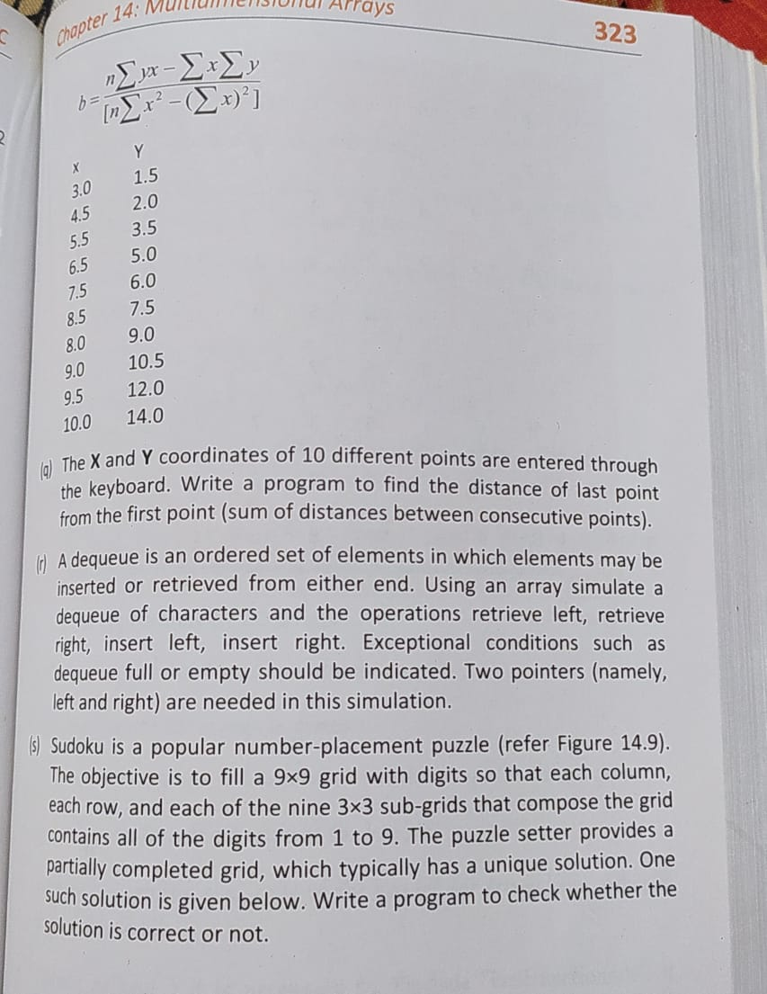
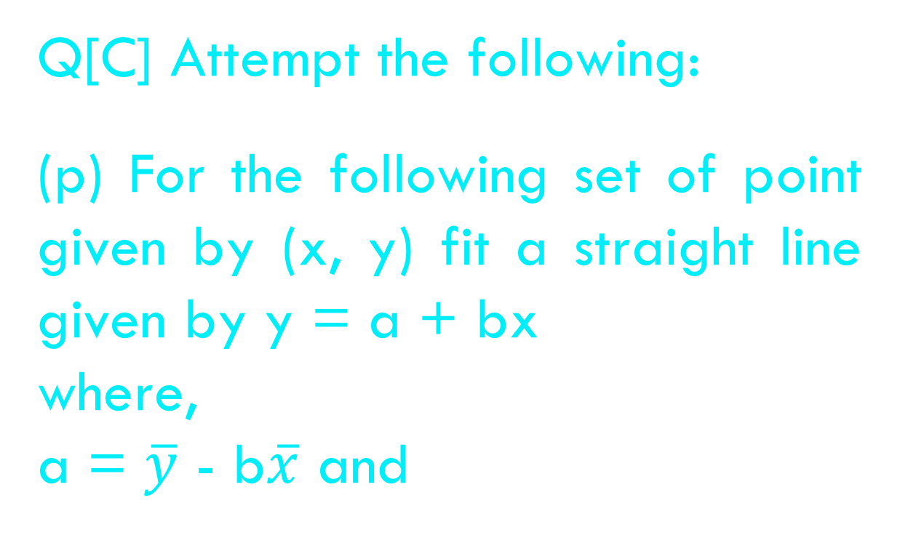
CHAPTER 14 SOLUTIONS
MULTIDIMENSIONAL ARRAYS
Q[C] Attempt the following:
(p) For the following set of point given by (x, y) fit a straight line given by y = a + bx
where,
a = $\overline{y}$ - b$\overline{x}$ and
CH 14 Q[C](p)
DEAR CODING
BOOK: LET US C
BY YASHAVANT KANETKAR

Slide 47
CHAPTER 14 SOLUTIONS
MULTIDIMENSIONAL ARRAYS
Q[C] Attempt the following:
(q) The X and Y coordinates of 10 different points are entered through the keyboard. Write a program to find the distance of last point from the first point (sum of distances between consecutive points).
CH 14 Q[C](q)
DEAR CODING
BOOK: LET US C
BY YASHAVANT KANETKAR

Slide 48
CHAPTER 14 SOLUTIONS
MULTIDIMENSIONAL ARRAYS
Q[C] Attempt the following:
(r) A dequeue is an ordered set of elements in which elements may be inserted or retrieved from either end. Using an array simulate a dequeue of characters and the operations retrieve left, retrieve right, insert left, insert right. Exceptional conditions such as dequeue full or empty should be indicated. Two pointers (namely, left and right) are needed in this simulation.
CH 14 Q[C](r)
DEAR CODING
BOOK: LET US C
BY YASHAVANT KANETKAR

Slide 49
CHAPTER 14 SOLUTIONS
MULTIDIMENSIONAL ARRAYS
Q[C] Attempt the following:
(s) Sudoku is a popular number-placement puzzle (refer Figure 14.9). The objective is to fill a 9x9 grid with digits so that each column, each row, and each of the nine 3×3 sub-grids that compose the grid contains all of the digits from 1 to 9. The puzzle setter provides a partially completed grid, which typically has a unique solution. One such solution is given below. Write a program to check whether the solution is correct or not.
CH 14 Q[C](s)
DEAR CODING
BOOK: LET US C
BY YASHAVANT KANETKAR

Slide 50
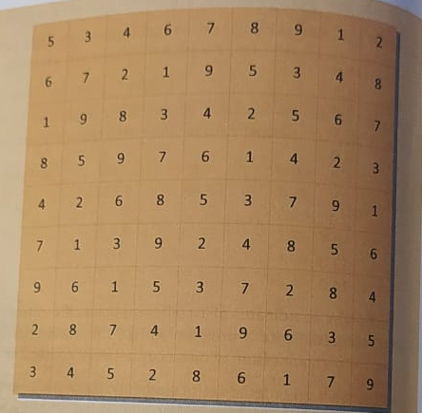
CHAPTER 14 SOLUTIONS
MULTIDIMENSIONAL ARRAYS
CH 14 Q[C](s)
DEAR CODING
BOOK: LET US C
BY YASHAVANT KANETKAR

Slide 51
LET US C
BY YASHAVANT KANETKAR
CH 15 Q[A]
CH 15 Q[C]
CH 15 Q[A]
CH 15 Q[B]
CHAPTER 15 SOLUTIONS
STRINGS

Slide 52


🔴Let me create amazing coding tutorials for you forever!🙂
👇👇👇👇👇👇👇👇👇👇👇👇👇👇👇👇👇👇
👉 SUBSCRIBE 🤛
CH 15 Q[C]
CH 15 Q[A]
CHAPTER 15 SOLUTIONS
STRINGS
CH 15 Q[B]
Thanks for your valuable time!

Slide 53
LET US C
BY YASHAVANT KANETKAR
CH 15 Q[C]
CH 15 Q[A]
CH 15 Q[B]
CHAPTER 15 SOLUTIONS
STRINGS

Slide 54
LET US C
BY YASHAVANT KANETKAR
CH 14 Q[B]
CH 14 Q[A]
CHAPTER 14 SOLUTIONS
MULTIDIMENSIONAL ARRAYS

Slide 55
LET US C
BY YASHAVANT KANETKAR
CH 14 Q[C]
CH 14 Q[A]
CH 14 Q[B]
CHAPTER 14 SOLUTIONS
MULTIDIMENSIONAL ARRAYS

Slide 56
LET US C
BY YASHAVANT KANETKAR
CH 12 Q[C]
CH 12 Q[A]
CH 12 Q[B]
CHAPTER 12 SOLUTIONS
THE C PREPROCESSOR

Slide 57
LET US C
BY YASHAVANT KANETKAR
CH 4 Q[E]
CH 4 Q[C]
CH 4 Q[A]
CH 4 Q[D]
CH 4 Q[B]
CHAPTER 4 SOLUTIONS
MORE COMPLEX DECISION MAKING

Slide 58
LET US C
BY YASHAVANT KANETKAR
CH 7 Q[B]
CH 7 Q[D]
CH 7 Q[A]
CH 7 Q[C]
CHAPTER 7 SOLUTIONS
CASE CONTROL INSTRUCTION

Slide 59
LET US C
BY YASHAVANT KANETKAR
CH 4 Q[B]
CH 4 Q[A]
CHAPTER 4 SOLUTIONS
MORE COMPLEX DECISION MAKING

Slide 60
LET US C
BY YASHAVANT KANETKAR
CH 15 Q[C]
CH 15 Q[A]
CH 15 Q[B]
CHAPTER 15 SOLUTIONS
STRINGS

Slide 61
LET US C
BY YASHAVANT KANETKAR
CH 15 Q[D]
CH 15 Q[B]
CH 15 Q[C]
CH 15 Q[A]
CHAPTER 15 SOLUTIONS
STRINGS

Slide 62
LET US C
BY YASHAVANT KANETKAR
CH 9 Q[B]
CH 9 Q[C]
CH 9 Q[A]
CHAPTER 9 SOLUTIONS
POINTERS

Slide 63
LET US C
BY YASHAVANT KANETKAR
CH 13 Q[I]
CH 13 Q[G]
CH 13 Q[E]
CH 13 Q[C]
CH 13 Q[A]
CH 13 Q[H]
CH 13 Q[F]
CH 13 Q[D]
CH 13 Q[B]
CHAPTER 13 SOLUTIONS
ARRAYS

Slide 64
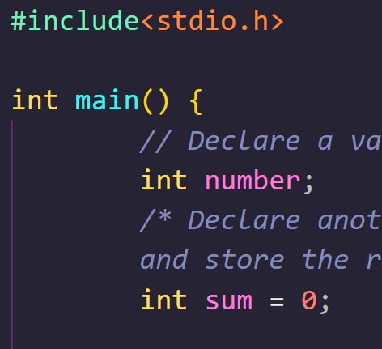
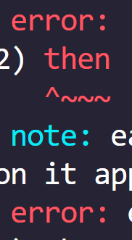

DEAR CODING

Slide 65
CHAPTER 14 SOLUTIONS
MULTIDIMENSIONAL ARRAYS
CH 14 Q[B]
Q[B] Point out the errors, if any, in the following C programs:
(b)
(c)
(a)
#include <stdio.h>
int main()
{
int j = 10, k = 12;
if (k >= j)
{
{
k = j;
j = k;
}
}
return 0;
}
(d)
#include <stdio.h>
int main()
{
float a = 12.214, b = 12.142;
if (a = b)
printf("a and b are equal\n");
return 0;
}
(e)
(f)
DEAR CODING
(g)
BOOK: LET US C
BY YASHAVANT KANETKAR

Slide 66

CHAPTER 14 SOLUTIONS
MULTIDIMENSIONAL ARRAYS
(a)
#include <stdio.h>
int main()
{
float a = 12.214, b = 12.142;
if (a = b)
printf("a and b are equal\n");
return 0;
}
CH 14 Q[B](a)
a == b
✅ No error!
👩‍💻 Output:
✍️ 12.142 gets assigned to a so the if is now reduced to if ( a ) or if ( 12.142 ). Since 12.142 isn’t non zero, it is true hence printf() gets executed.
DEAR CODING
BOOK: LET US C
BY YASHAVANT KANETKAR

Slide 67
CHAPTER 14 SOLUTIONS
MULTIDIMENSIONAL ARRAYS
(d)
#include <stdio.h>
int main()
{
int x = 10;
if (x >= 2) then
printf("%d\n", x);
return 0;
}
CH 14 Q[B](d)
❌
ERROR!
DEAR CODING
✍️ There is no keyword "then“ in C & no variable defined here in program as well.
BOOK: LET US C
BY YASHAVANT KANETKAR

Slide 68

CHAPTER 14 SOLUTIONS
MULTIDIMENSIONAL ARRAYS
(d)
#include <stdio.h>
int main()
{
int x = 10;
if (x >= 2)
printf("%d\n", x);
return 0;
}
CH 14 Q[B](d)
DEAR CODING
BOOK: LET US C
BY YASHAVANT KANETKAR

Slide 69
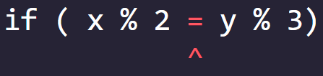
CHAPTER 14 SOLUTIONS
MULTIDIMENSIONAL ARRAYS
(e)
#include <stdio.h>
int main()
{
int x = 10, y = 114;
if ( x % 2 = y % 3)
printf("Carpathians\n");
return 0;
}
CH 14 Q[B](e)
❌ ERROR!
✍️ C allows only one variable on left hand side of “=“ assignment operator.
DEAR CODING
BOOK: LET US C
BY YASHAVANT KANETKAR

Slide 70
CHAPTER 14 SOLUTIONS
MULTIDIMENSIONAL ARRAYS
Q[C] Attempt the following:
(a) If cost price and selling price of an item are input through the keyboard, write a program to determine whether the seller has made profit or incurred loss. Also determine how much profit he made or loss he incurred.
CH 14 Q[C](a)
DEAR CODING
BOOK: LET US C
BY YASHAVANT KANETKAR

